Slide 1
IO Concept
List iterator
Complete by io_concept.hpp
Not Implement for now
derive
derive
Driver Entity
Complete by peripheral_driver.hpp
Derive & implement
Driver implementation
Contain as a pointer
Device prototype
Complete by Chip Support Package
Such as: csp/stm32/stm32_peri_impl.hpp
Complete by device_prototype.hpp
Derive & strength
Derive & implement
User Extension for the peripheral
Concrete Device
Complete by Library User
This is the outer of the library
Complete by specified physical driver
Such as: ext/sensor/bmp180.h
Workflow class
Contain an object
Device workflow
Workflow class
Contain an object array
Complete by specified physical driver and general usage routine
Such as: ext/sensor/bmp180_workflow.h

Slide 2
第一层：纯虚函数基类
IO Concept
List iterator
Complete by io_concept.hpp
Not Implement for now
derive
derive
第二层：给出一个多继承的框架
Driver Entity
Complete by peripheral_driver.hpp
Derive & implement
Driver implementation
Contain as a pointer
Device prototype
第三层：实现上面的框架
Complete by Chip Support Package
Such as: csp/stm32/stm32_peri_impl.hpp
Complete by device_prototype.hpp
Derive & strength
Derive & implement
User Extension for the peripheral
Concrete Device
Complete by Library User
This is the outer of the library
Complete by specified physical driver
Such as: ext/sensor/bmp180.h
Workflow class
Contain an object
Device workflow
Workflow class
Contain an object array
Complete by specified physical driver and general usage routine
Such as: ext/sensor/bmp180_workflow.h

Slide 3
Genealogy for IO concept
RWDS
RW
RWD
IO Concept
Read
Write
ReadWrite
Seek
concept_read_single
concept_write_single
concept_readwrite_single
gmp_concept_seek
Atom
concept_rw_single
R/W one by one
concept_rwd_single
concept_rwds_single
R/W a whole string
String
concept_read_direct
concept_write_direct
concept_readwrite_direct
concept_rw_direct
R/W a whole string with address
Address
concept_rwd_direct
concept_read_with_addr
concept_write_with_addr
R/W one by one with address
Atom Address
concept_rw_with_addr
R/W a whole string with dual-address
Dual Addr
concept_read_with_dualaddr
concept_write_with_dualaddr
concept_rw_with_dualaddr
R/W one by one with dual-address
Atom Dual addr

Slide 4
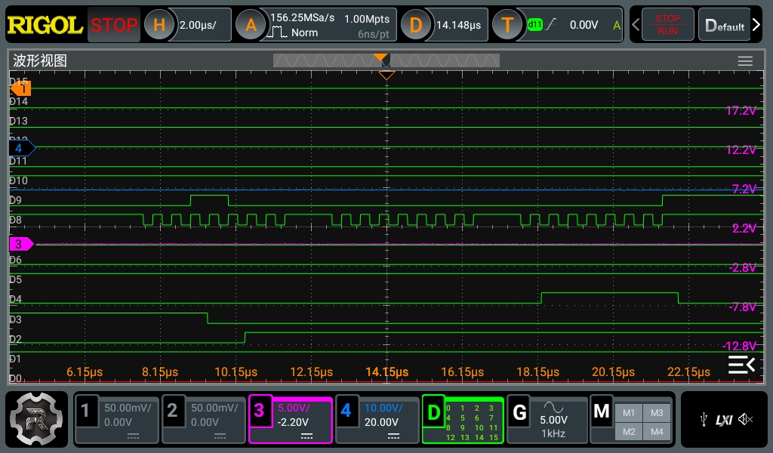
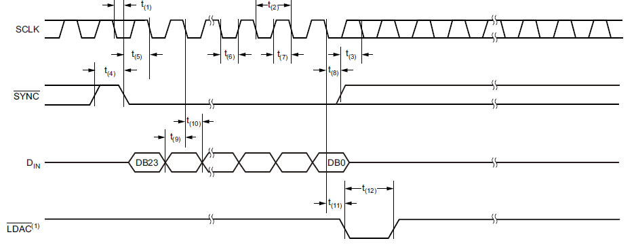

Slide 5
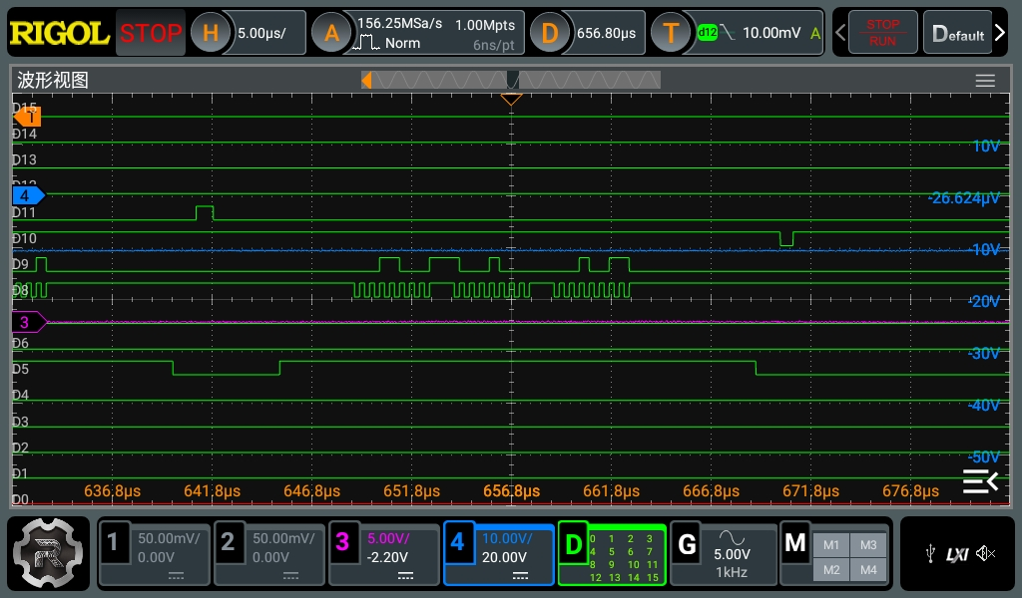

Slide 6
